Slide 1
An Analysis of Societal Reactions to the Nice Attack
Online Conversations & On-the-Ground Events

Slide 2
Nice Attack in Context of Hashtag Campaigns
Part of broader study on the role of hashtag campaigns in CVE efforts
Utilizes a communications framework
Public communication campaigns
Crisis and disaster communication

Slide 3
Public Communication Campaigns
Public communication campaign: purposive attempts to inform or influence behaviors in large audiences within a specified time period using an organized set of communication activities and featuring an array of mediated messages in multiple channels generally to noncommercial benefits to individuals and society (Rice & Atkin, 2009; Rogers & Storey, 1987)
Aim: changing individual behavior OR mobilizing the public
Campaigns affect individuals on three different levels
Cognitive
Attitude
Behavior
Community level: assess changes in social environment
Notes:
Go into nuances of the evaluation framework later

Slide 4
Attack Summary
July 14 (10:40pm), Mohamed Lahouaiej Bouhlel drove a 19-tonne truck through a crowd of about 30,000 people watching a fireworks show on the Promenade de Anglais
The heaviest life toll takes place along a 1.9km stretch from 11 to 147 Promenade des Anglais
Around 23:00, the driver is shot dead; 84 people are killed, 303 injured
Suspect identified
Notes:
Death and injured sources: Reuters and New York Times

Slide 5
Attack Summary
July 15 (04:00) President Hollande gives a televised address
Makes remark on the “terrorist nature of the attack”
State of emergency is extended by 3 months
July 16: The Islamic State claims responsibility for the attack via the Amaq news agency
3 people associated with Bouhlel arrested
3 days of national mourning
July 17: more arrests
Bouhlel’s wife is released
July 18: moment of silence

Slide 6
Nice Attack Case Study
An analysis of tweets surrounding the terrorist attack in Nice, France on July 14, 2016
Over 6.8 million tweets
1 week period (July 13 – 21)

Slide 7
Nice Attack Case Study
Query Search Based on 17 most used hashtags
Notes:
Not included in this query, but which could yield some interesting results is the hashtag #ISIS.

Slide 8
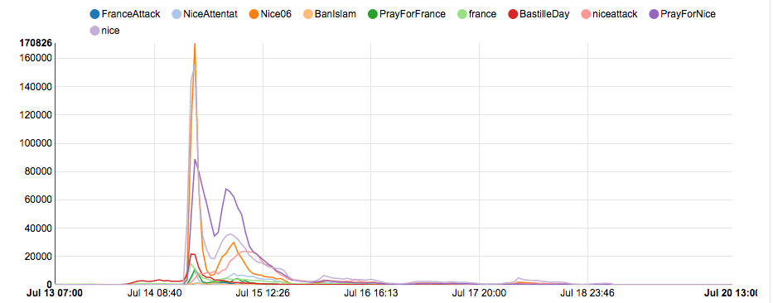
Nice Attack Tweet Waves
Eight waves identified.
Notes:
Based on the 10 most used hashtags

Slide 9
July 14 (22:40 – 23:00)
Majority of tweets (81.42%) of tweets collected (n = 3,041) were associated with Bastille Day celebrations & other non-related events
Witness accounts (14.6%)
Sharing general information (2.53%)
Seeking information (1.45%)
Notes:
Irrelevant: Bastille Day celebrations (firework shows, concert in Paris); New British Foreign Minister, Boris Johnson, hostile welcome

Slide 10
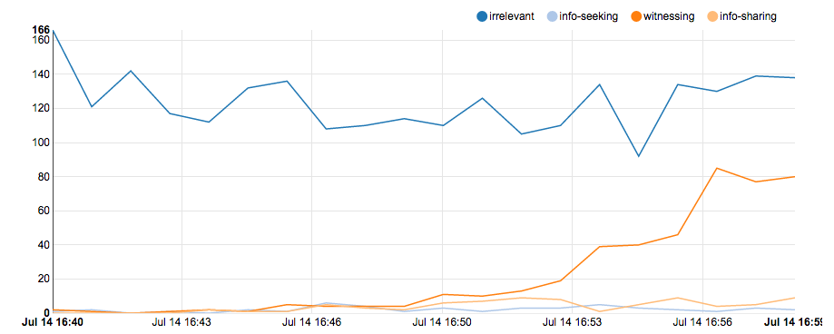
July 14 (22:40 – 23:00)
Tweets within first 20 minutes of attack

Slide 11
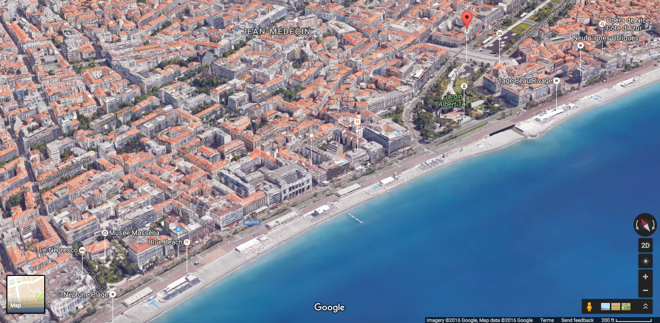
Nice, France

Slide 12
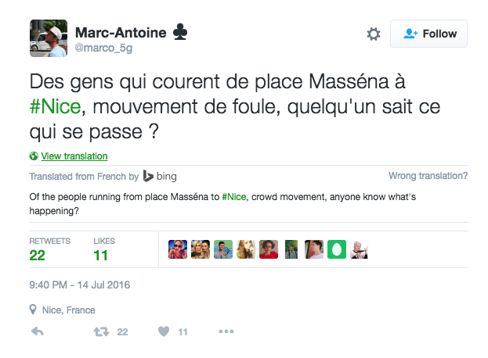
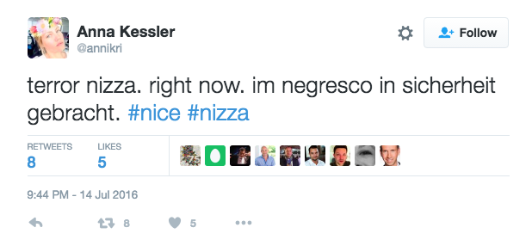
July 14 (22:40 – 23:00)
Witness accounts
Notes:
@marco_5g: “People who run from the Place Massena in Nice, panic, does anyone know what’s happening?”
@annikri: “Terror in Nice. Right now. I’m at the Negresco. I’ve made myself safe.”

Slide 13
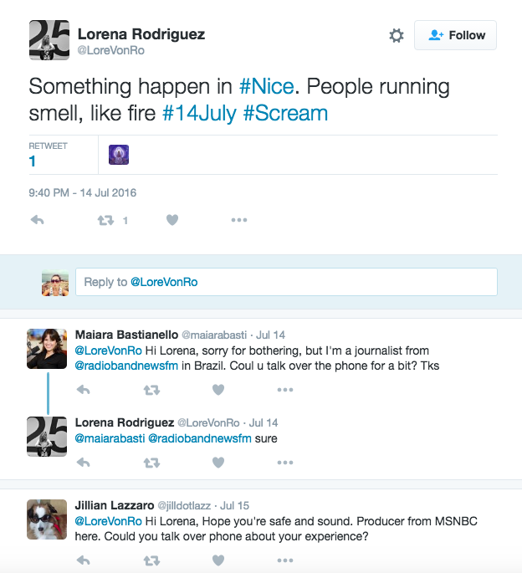
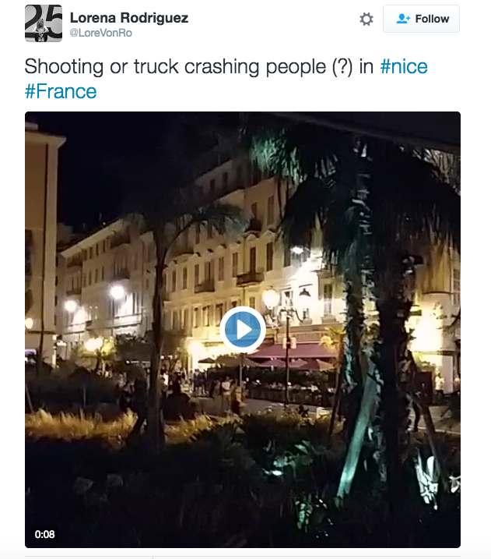
July 14 (22:40 – 23:00)
Capturing journalists’ attention:
22:40:44 (time in France)
22:45:25 (time in France)
Notes:
@LoreVonRo [video]: received 70 retweets, 25 likes, contacted by 17 journalists, including from The Associated Press (AP), ABC, Agencia EFE, CNN, NBC, Storyful

Slide 14
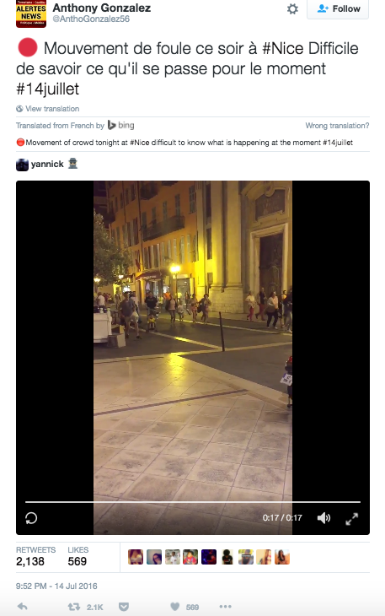
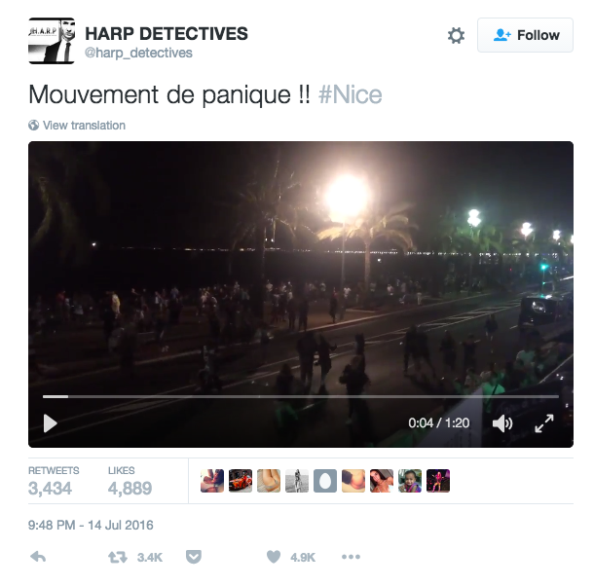
July 14 (22:40 – 23:00)
Most Retweeted
Notes:
@harp_detectives = Office of Investigations and specialized information in civil and commercial matters and in new technologies (Private Detective Nice)
Retweets: 3,525
@AnthoGonzalez56 = Panic tonight in Nice. Difficult to understand what is currently happening #14July
Retweets: 2,138

Slide 15
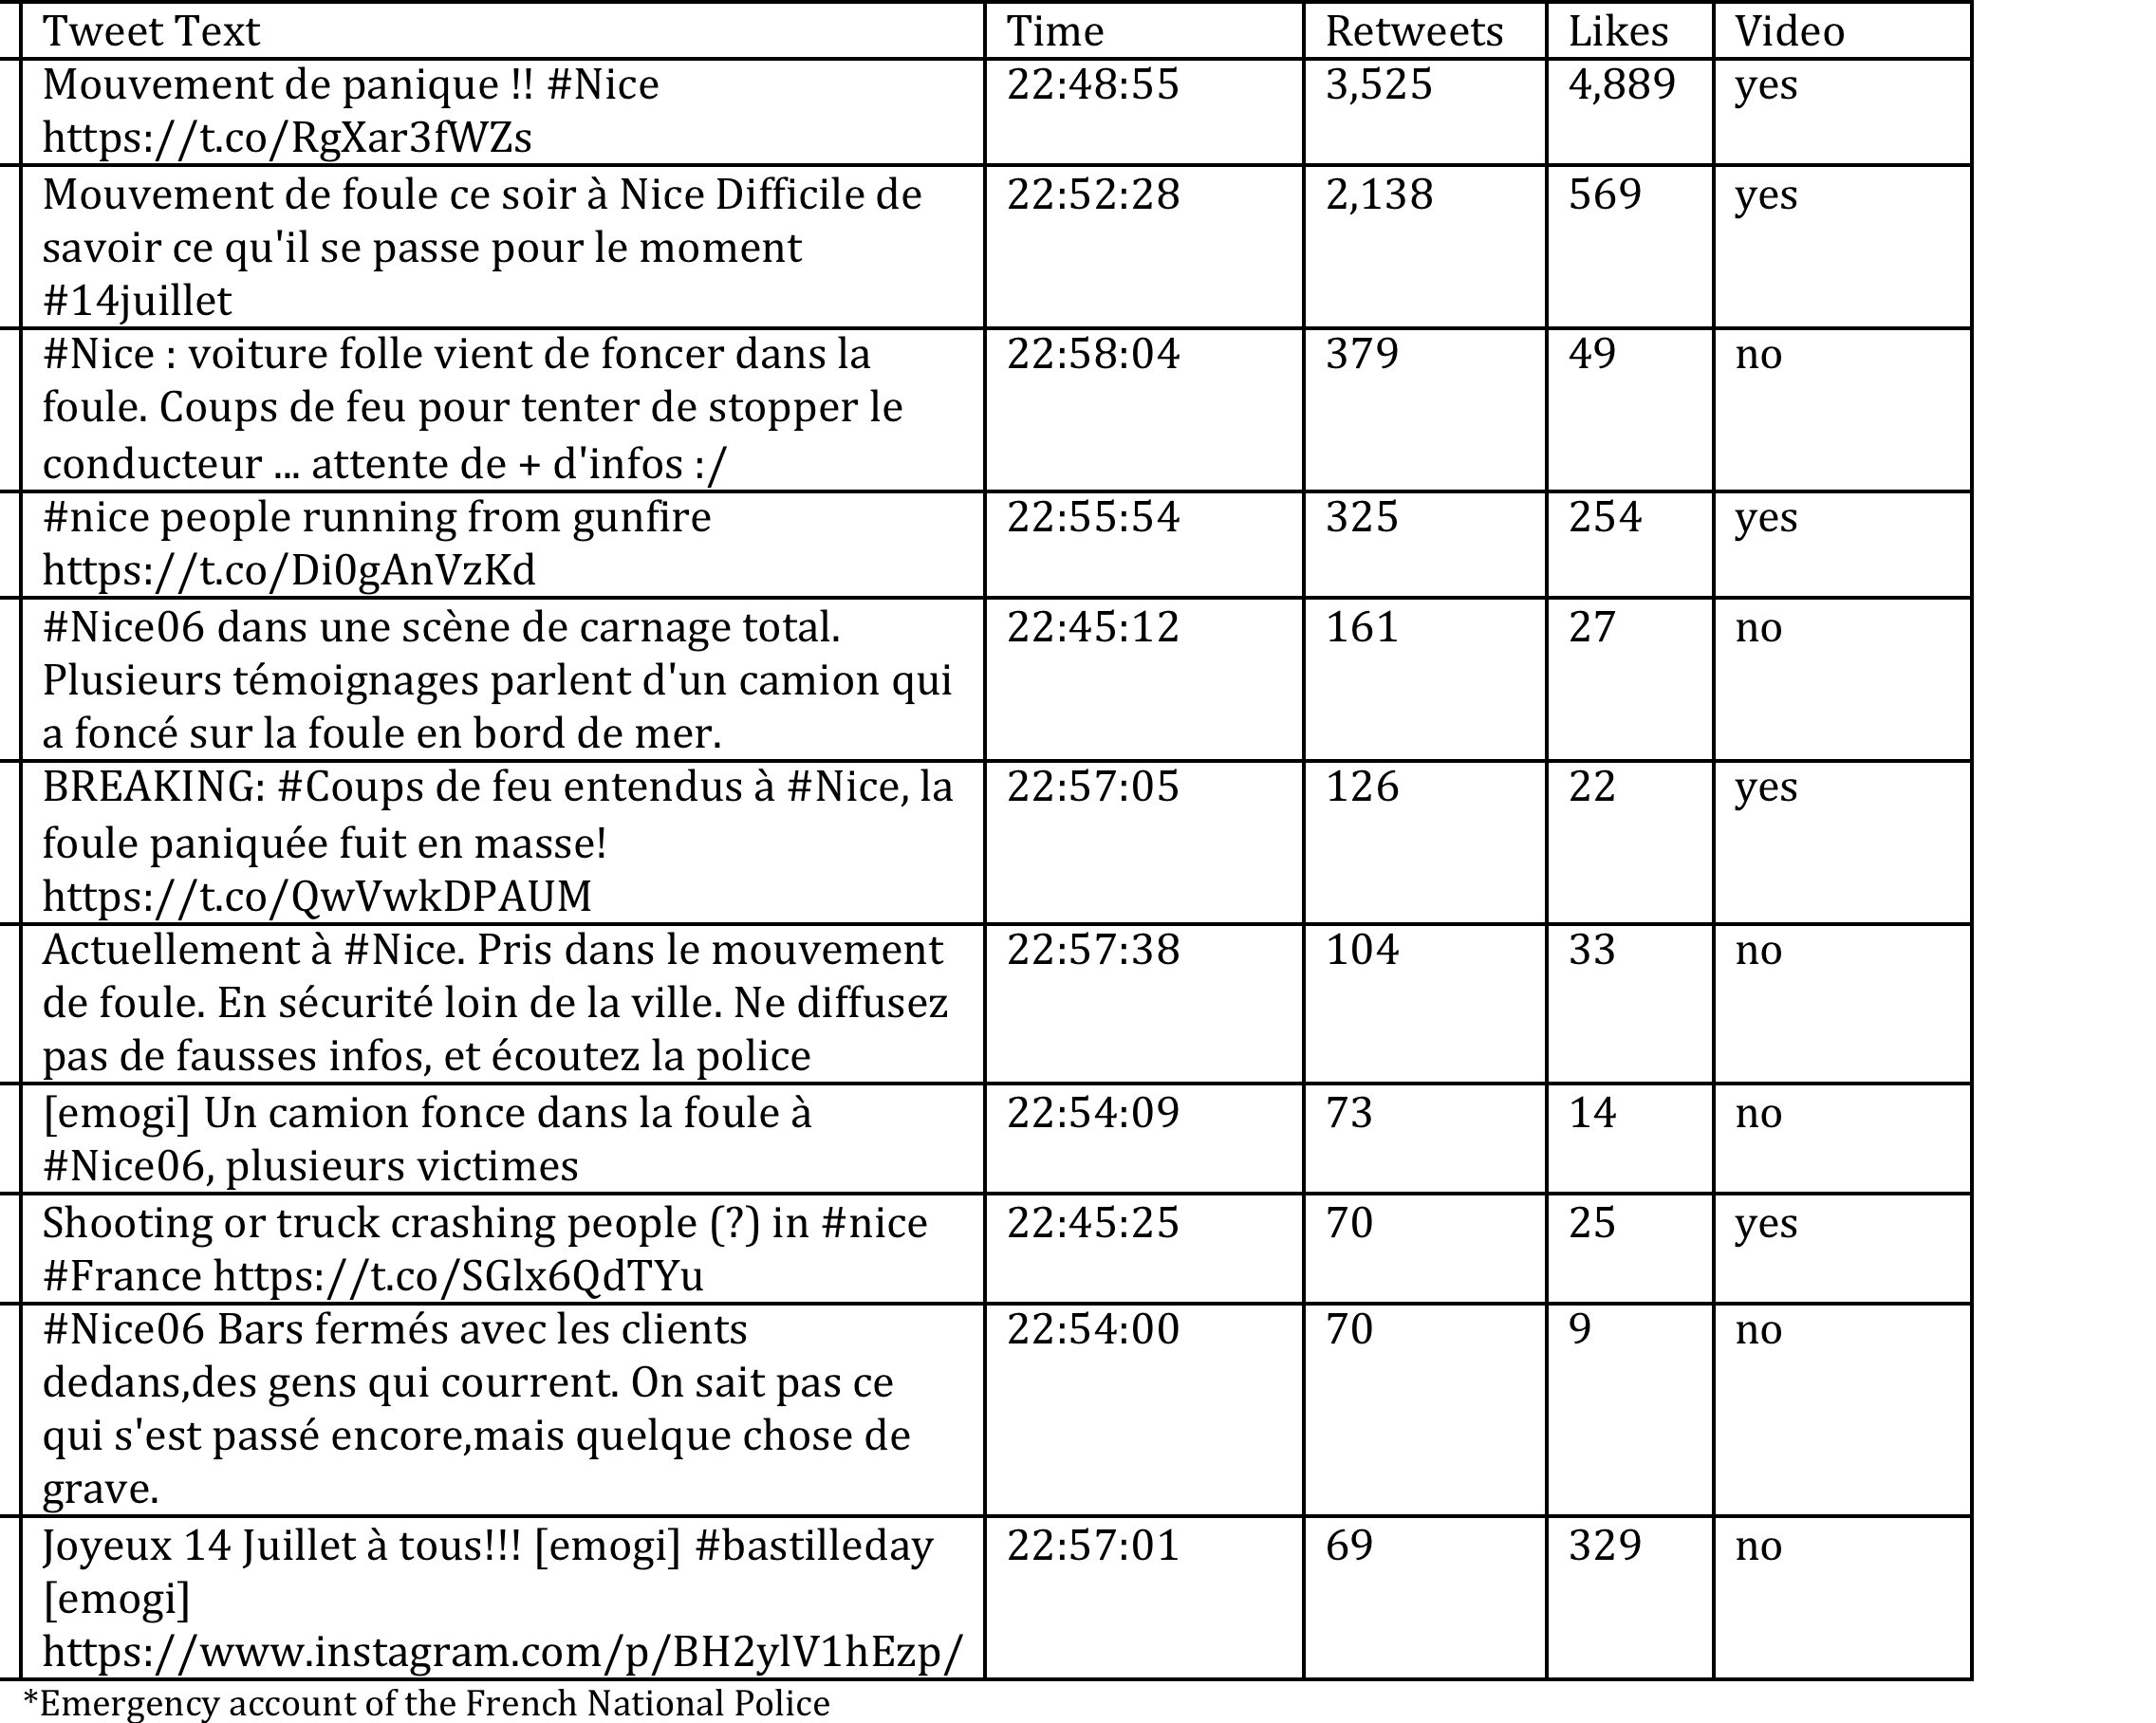
July 14 (22:40 – 23:00)
Top 11 Tweets

Slide 16
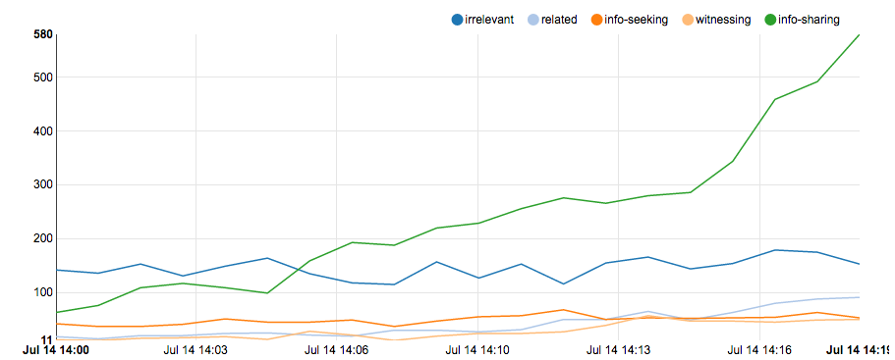
July 14 (23:00 – 23:20)
Tweet Themes Over Time
Notes:
Rise in information sharing
Plateauing of witness accounts as well as information-seeking
Related tweets are mostly emotional reactions (i.e. condolences, etc.)

Slide 17
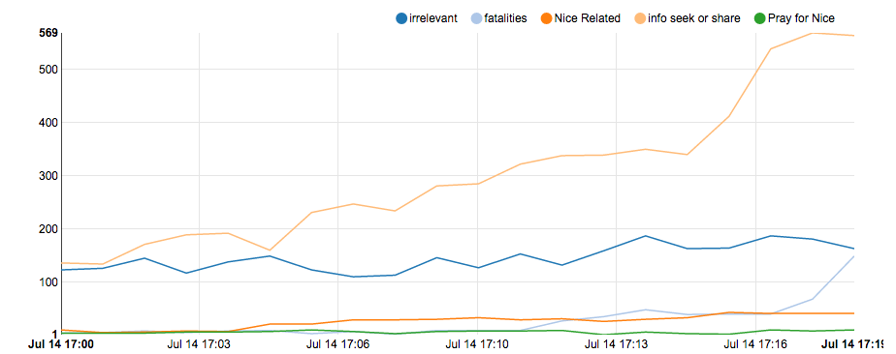
July 14 (23:00 – 23:20)
Rise of New Themes

Slide 18
July 14 (23:00 – 23:20)
Top 10 Tweets
 | Text | Retweets | Likes | Video
1 | BREAKING: Panic in #Nice, France after #truck drives into crowd at promenade http://on.rt.com/7iwe | 2,951 | 1,566 | yes
2 | #Nice > La préfecture des Alpes-Maritimes évoque un attentat, et demande aux habitants de rester cloîtrés | 2,668 | 466 | no
3 | #Nice > Un véhicule fonce dans la foule sur la Promenade des Anglais, des victimes (mairie, témoins) | 2,424 | 517 | no
4 | Scènes de chaos à #Nice où il y aurait des dizaines de blessés après qu'un camion ait foncé dans la foule! #Attentat | 1,798 | 522 | yes
5 | 🚨 Un camion fonce dans la foule à #Nice, Promenade des Anglais, après le feu d'artifice 😱😔😣 Plusieurs victimes... Quelle horreur ! | 1,607 | 928 | no
6 | Horreur à #Nice où un #camion a foncé dans la foule: beaucoup de blessés et probablement des morts. #Attentat | 1,546 | 337 | no
7 | I'm in #nice and cannot describe the situation- scary awful. Dead bodies everywhere people killed in front of my eyes. Had to b planned | 1,106 | 343 | no
8 | #Nizza/#Nice: Mass panic in #Nice. Vehicle crashed into a celebrating crowd. Reports of a shooting. #BastilleDay https://t.co/RJyAMiSW0d | 646 | 164 | yes
9 | Le #feudartifice du #14juillet, c'est parti ! 🎉✨ | 660 | 1,059 | no
10 | #nice saw moving truck driving full speed over crowd on promenade for at least 2-3 miles. Then massive gunfire. | 643 | 137 | no

Slide 19
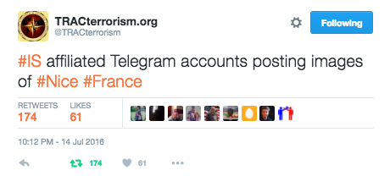
July 14 (23:00 – 23:20)
Signals of ISIS involvement.
Notes:
Related: anger/frustration with BFMTV and iTele for continuing to air scenes of fireworks and the Eifel Tower; etiquette revolving around sharing photos; ISIS posting pictures of attack
Misinformation: drive-by-shooting; bombing; shooting; car crash

Slide 20
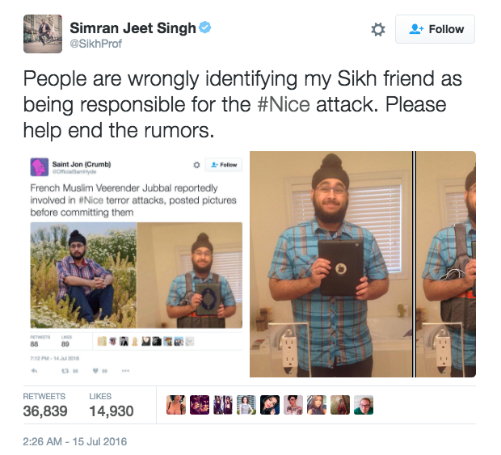
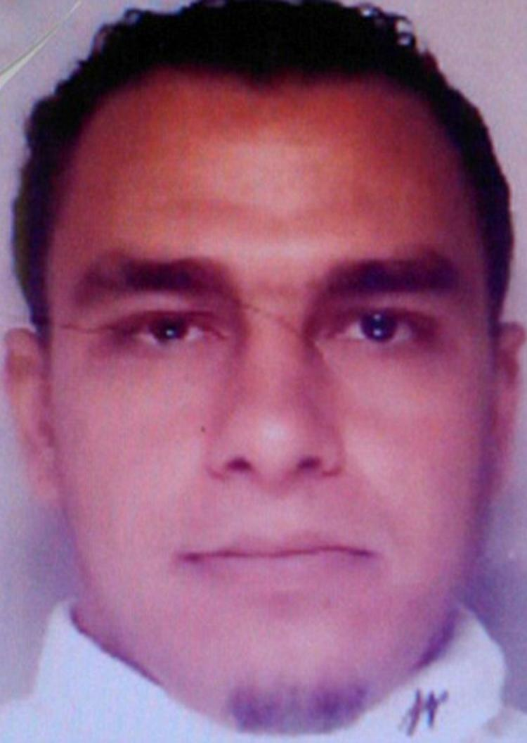
July 15 – Suspect Identified
Misidentification
Bouhlel

Slide 21
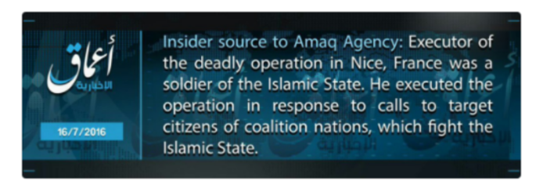
July 16 - Saturday
Islamic State claims Bouhlel as a “soldier of the Islamic State”

Slide 22
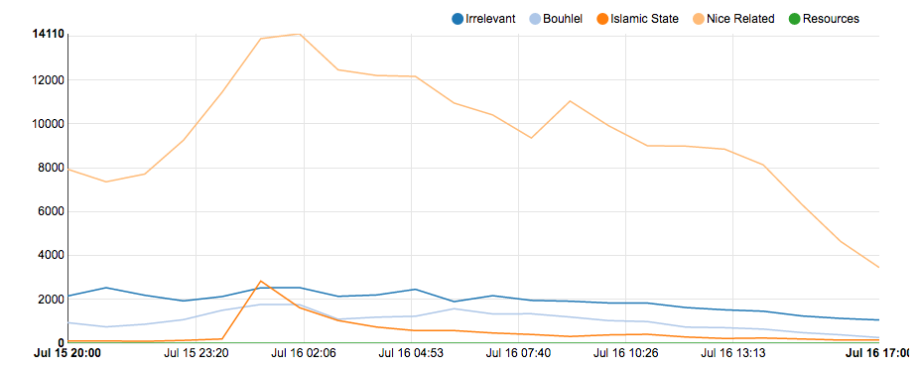
July 16
Tweet Themes Over Time (July 16 T 04:00 – July 17 T 02:00)

Slide 23
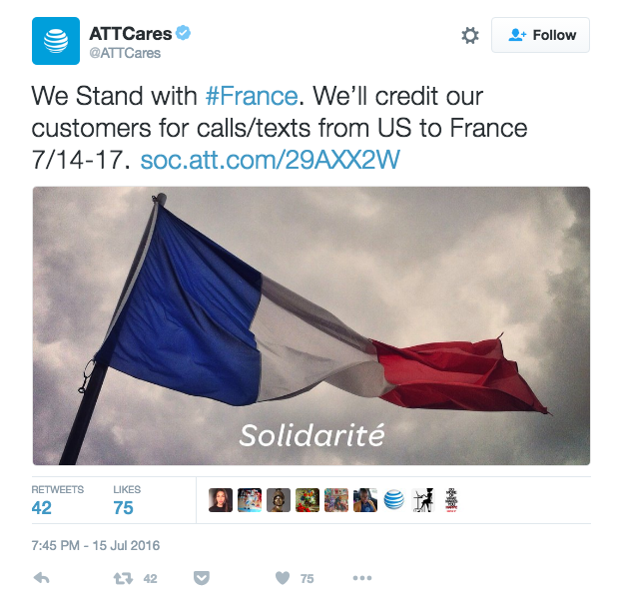
Resources

Slide 24
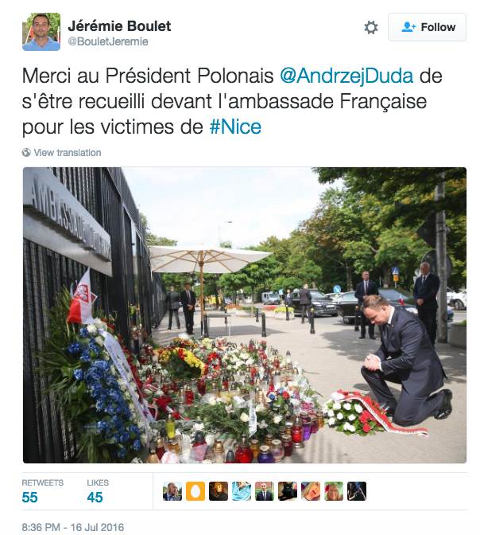
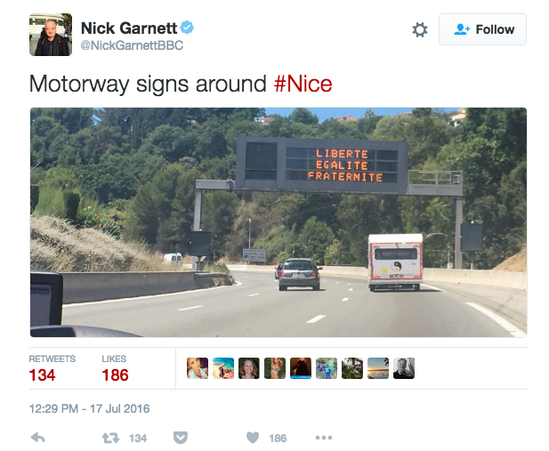
Solidarity

Slide 25
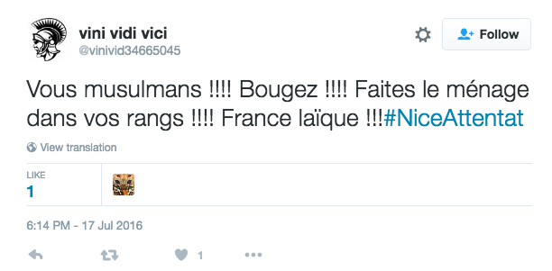
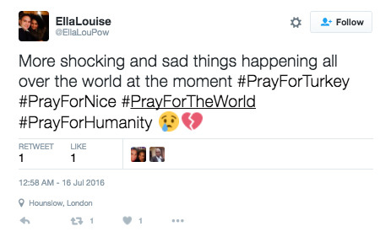
Negative Sentiment
Anti-Islamic / Anti-Muslim
Despair and Hopelessness
Many perpetuated by the far-right

Slide 26
Highlights
Trends and Patterns to Note
Initial aftermath:
Crisis comes to dominates the Twitter stream
Witness accounts
Attempts to determine what’s going on
Media takeover
Suspect identification & misidentification
After event details solidifying
Solidarity themes
Gradual rise in negativity
Downward interest in details of the aftermath

Slide 27
Tweet Waves
Nice Related Hashtag Frequency

Slide 28
Questions?
Thank you.
Suzzette Lopez Abbasciano
abbasciano.s.l@gmail.com
@NukGrl

Slide 29
Public Communication Campaigns
The success of a campaign is associated with:
Use of coordinated media efforts
Involvement of interpersonal & community-based communication channels (Coffman 2002)
Greatest impact → reinforce an already favorable message
Possible to persuade “at risk” population
Only minor changes (if any) with those staunch in practice
Indirect influence
Target potential interpersonal influencers who can motivate key individuals (Rogers, 2003)

Slide 30
Public Communication Campaigns
Effects on opinion and behavior
Connections among individuals within a community can amplify or dampen campaign effects (Hornik & Panovitzky, 2003; Southwell et al., 2010)
Conversation is important for actual behavior change to occur (Rogers, 2002; Valente & Saba, 1998)
Health behaviors are heavily influenced by social contextual factors as well as exposure to health-related information through mediated and interpersonal sources (Biglan, et al., 2012; Merzel & D’Afflitti, 2003)
Campaign exposure on attitude toward parent-child communication about drugs larger for parents with low level of social capital (Lee & Kam, 2014)
Notes:
connections among individuals within a community either amplify or dampen campaign effects
conversation is important for actual behavior change to occur
Health communication scholars and public health practitioners have accentuated the importance of actual or potential resources embedded within a community, such as social capital, because health behaviors are as heavily influenced by social contextual factors as by exposure to health-related information through mediated and interpersonal sources
Southwell and Torres’s (2006) call for “the need to theorize about the mechanism by which mere exposure might encourage conversation when it other- wise would not have taken place”
Important: It shows that campaigns have a place; they play a role in generating conversation. It’s not a question of: “Is a campaign necessary?” or “is that campaign playing out have role at all?”

Slide 31
Crisis & Disaster Communication
Traditional focus: relationship between crisis type and communication strategy → on public reactions
Less attention: on the medium or the public’s secondary crisis communication (Utz et al. 2013)
The medium has stronger effects than the type of crisis
Social media use increases during crises (Pew Internet & American Life, 2010)
Notes:
traditional communication channels, especially telephone and mobile networks, become saturated

Slide 32
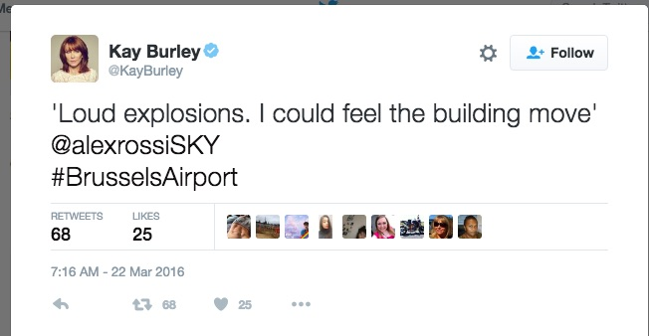
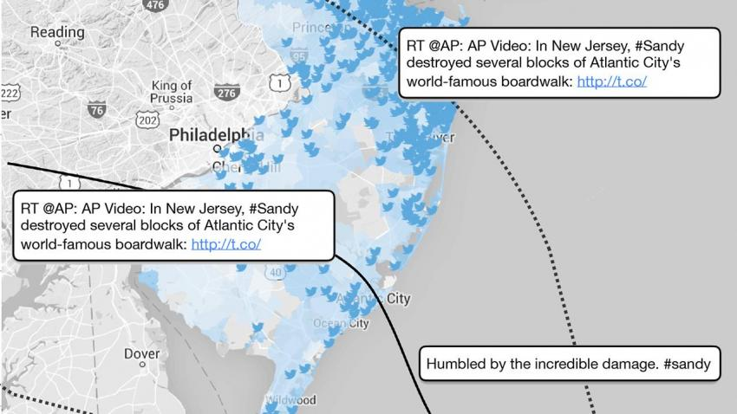
Crisis & Disaster Communication
What can we learn by analyzing social media use during a crisis?
Alert system
On-the-ground information
“a revealing measure of public distress” (Hotz, 2016)
Notes:
The ways social media has been utilized has also evolved and expanded.
Apart from simply being a vehicle for noting and alerting others that a crisis or disaster is or has taken place, Facebook, Twitter and other platforms allow users to share on-the-ground information as a disaster unfolds. The information each records are considered “a revealing measure of public distress” (Hotz 2016). As a provider of real-time information, Twitter, in particular, “successfully tackles a niche…[it] has become our global emergency information system” (Hempel 2014). It is “a real-time sensor network” (…).

Slide 33
Crisis & Disaster Communication
Can reach an audience that might otherwise not get involved
New accounts
Greater community representation?
Allows organizations to engage in a dialogue with the public
accountability
Provides information not available in other channels
Emotional support and recovery from crises
Photo sharing = informative & therapeutic role
→ showcase community resolve (Silverman, 2016)
Flickr: a community forum for grassroots activity
→ facilitate community building (Liu et al, 2008)
Notes:
Photos can help document and better understand an event. The act of sharing photos plays an informative and therapeutic role. It can help people become more entwined with a disruptive situation and to showcase community resolve (Silverman 2016).
In a study of 29 Flickr groups across six disasters it was found that the platform acts as a community forum for disaster-related grassroots activity and can facilitate community building (Liu et al. 2008). One participant commented that “…each photo is like a landmark or a virtual space where people can meet and have a conversation” (Ibid).

Slide 34
Crisis & Disaster Communication
Research on information & communication behaviors in emergency preparedness, response, & recovery is in its infancy (Reeder, H., et al., 2014)
Social media & communication technology have shifted the power of communication from public relations practitioners to social media users
Post-disaster tweets can showcase users’ declarations of involvement, connection to the community, debates regarding the effectiveness and credibility of relief efforts, promotion of relief efforts, and calls to action (Smith, 2010)
Notes:
Skip if necessary
Social media, however, allows individuals to interact with officials to collect, critique, debunk, and share information of their own

Slide 35
Crisis & Disaster Communication
Social media provides information not available in other channels along with emotional support & recovery from crises (Choi & Lin, 2009; Stephens & Malone, 2009)
Non-profit organizations’ social media content are associated with more positive emotions than traditional media sources and this helped gain support for relief efforts (Muralidharan, et al., 2011)
Who becomes involved is important
Notes:
Who becomes involved in social media campaigns during tumultuous moments matters. Prominent members of society such as athletes, celebrities, and international figureheads can draw a considerable amount of attention to an event quickly. Vast awareness can benefit relief efforts by tapping into a greater pool of funding, shelter, transportation, food, and first aid resources. In the aftermath of the earthquake in Haiti, world renowned actors, journalists, and musicians disseminated information on how to donate money to the Red Cross and other organizations providing relief efforts, such as Haitian native Wyclef Jean’s foundation Yele (Wortham, 2010). Diverse segments of the affected community, as well as the general population, become involved. Nonetheless, there can also be detrimental effects if a campaign receives an insurmountable volume of attention or an off-putting individual becomes involved. Too much attention, especially over an expanded period of time, can dishearten followers or outlast their concentration.

