Slide 1
The (Extreme) Right Online
Reem Ahmed & Daniela Pisoiu
ISA, Baltimore
23 February 2017

Slide 2
Outline
Background into research and methods
Navigating the right-wing scene
Data and method
Initial observations
Further questions and future research

Slide 3
Source: http://www.oe24.at/oesterreich/Erstes-Foto-von-FPOe-Chef-Strache-mit-Neo-Nazi-Gruss/76669

Slide 4
Violent online political extremism: previous studies and methods
Attempts to empirically clarify the effects of the Internet on radicalization and violent extremism (e.g. Gill et al. 2015; von Behr et al. 2013; Koehler 2014)
Collaborations between social scientists and computer scientists – machine learning, data mining
Social Network Analysis (SNA) – network centrality, topic, and location mapping (e.g. Carter et al. 2014; Caiani and Wagemann 2009)
Content analysis
Platforms – Twitter, Facebook, YouTube

Slide 5
Navigating the right-wing scene: distinctions and overlaps
Populists have made a certain amount of ’progress’ towards gaining political power
Refugee crisis and terrorist attacks in Europe and the US
Right-wing extremism also on the rise

Slide 6
Neo-Nazis – white supremacists – alt-right –anti-immigration
The lines are blurred especially with regard to discourse
Populists have tried to (officially) distance themselves from outwardly neo-Nazi rhetoric
Dividing lines are drawn on culture rather than race
Extremist parties relatively defunct cf. BNP – UKIP, NPD – AfD

Slide 7
Is there a connection?
Does right-wing extremism feed off right-wing populism?
Does one lead to the other?
Are the two evolving parallel to each other?

Slide 8
Data & Method
Exploratory study – data collected by VOX-Pol researchers
175 EU-based extreme right Twitter accounts
37,378 tweets collected between 26-30 September 2016
Seed accounts identified
Follower relationships extracted – accounts with 100,000+ followers excluded
SNA – determine central accounts
Dataset checked manually – irrelevant, accounts linked to populist parties, and/or US-based accounts excluded
Some EU-based accounts that were not central in the SNA were purposively sampled and added to the final list

Slide 9
Data & Method
Looked at hashtag co-occurrence to map overlaps – SNA
Hashtags direct users to topics and debates. They can also be used to infiltrate certain debates
URLs collected to see what platforms were linked-to
34.7% of the tweets contained URLs and 23.2% of the tweets contained hashtags

Slide 10
Initial Observations
Already difficult to differentiate during data collection
#WhiteGenocide the most frequently used hashtag
Hashtag | Count
#WhiteGenocide | 899
#afd | 527
#Dresden | 503
#DebateNight | 434
#Trump | 328
#ALVDE | 282
#islam | 261
#DossierTabou | 257
Merkel | 212
MAGA | 188

Slide 11
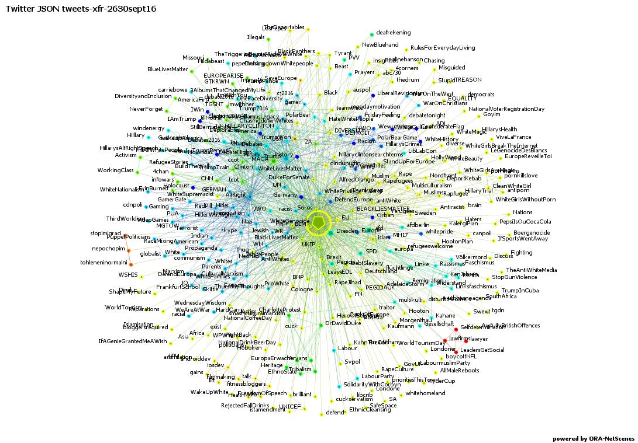
Hashtag co-occurrence #WhiteGenocide
Left-wing and liberal mainstream:
#BlackLivesMatter
#LabourParty
#StopGunViolence
#refugeeswelcome
Possibly due to ‘inter-ideological mingling’ (Graham 2016)
Populist:
#Brexit
#UKIP
#TRUMP
#afdBerlin
Extremist:
#WhiteLivesMatter
#DukeForSenate
#Hitler
#Nazi
#RaceMixingAmerican

Slide 12
Hashtag co-occurrence #Trump and #afd
Trump:
#WhiteGenocide
#Holohoax
#Pepe
AfD:
#NPD
#Pegida
#Burkaverbot
#stoprefugees
#kölnhbf

Slide 13
Hashtag co-occurrence #AltRight
#WhiteGenocide
#BuildTheWall
#HitlerWasRight
#tcot
#ccot
Alt-right very active on social media, especially during Trump campaign
SPLC argues that the hashtag has been used widely on Twitter to inject their ideas into the mainstream

Slide 14
URLs
YouTube and Facebook
breitbart.com
express.co.uk
dailymail.co.uk
rt.com
Twitter used mostly to disseminate content related to Muslims, immigrants and the US elections, rather than advocate violence

Slide 15
Further questions
Populist parties and figures form bridges between anti-immigration rhetoric and white supremacist and neo-Nazi discourse
Why do these overlaps exist?
Are they largely the result of trolling, or is there real cause for concern regarding right-wing populist groups?
Are right-wing populist parties a front for the more extreme, or are extreme members only a minority?
Is this part of a broader strategy from the extreme right, or is there a general move within society towards the right?

Slide 16
Future research
More platforms – Twitter mostly used for dissemination. Would other platforms reveal different results?
Frame analysis – the role of discourse in mobilization
Problems only become relevant as motivations for mobilization when they are formulated as such, and in such a way as to resonate with the audience
Thus, which themes resonate with these groups in particular and how are these messages constructed?

Slide 17
Thank You

