Slide 1
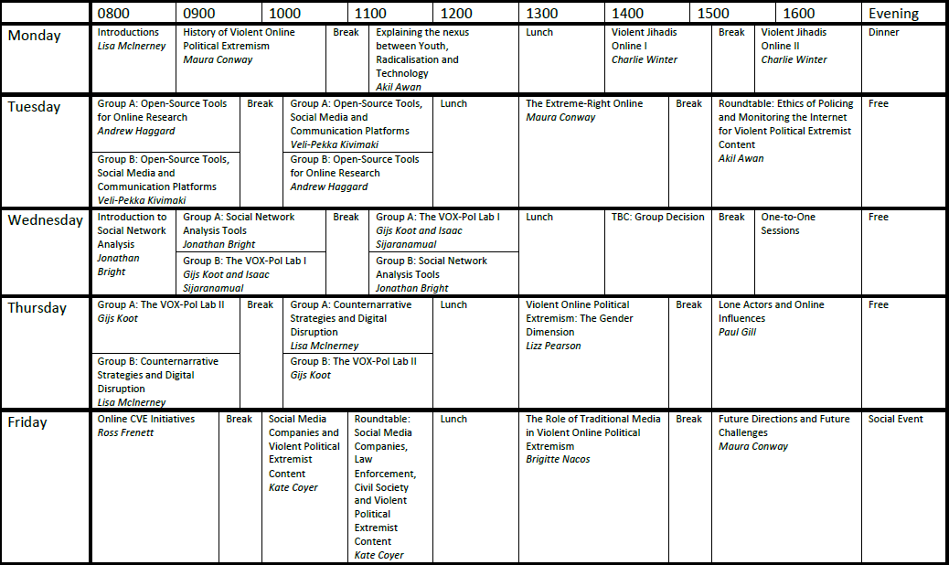
VOX-Pol TRAINING ACADEMY SCHEDULE

