Slide 1
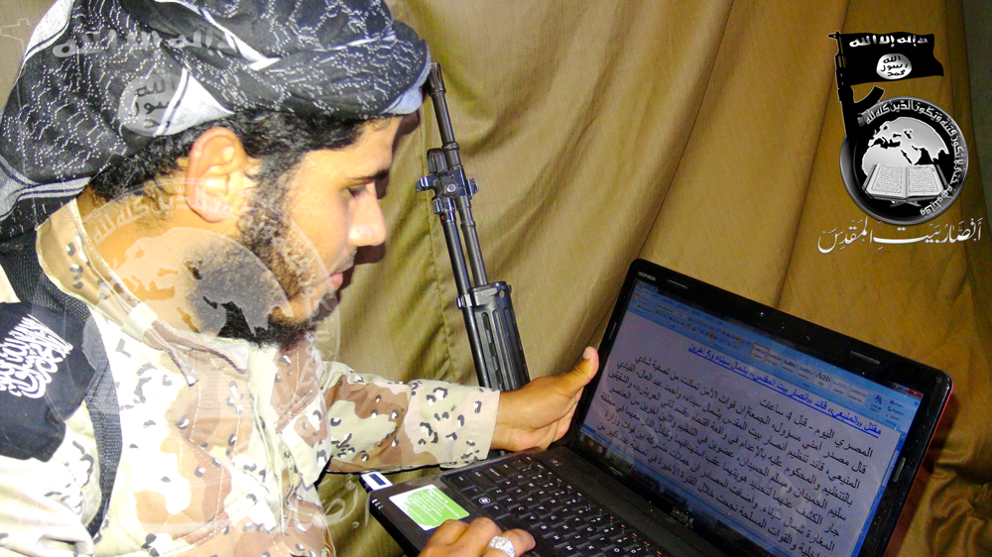
The Use of the Internet by the “Islamic State”
Online Territories of Terror and Real-World Operations
Nico Prucha
ICSR, King’s College London

Slide 2
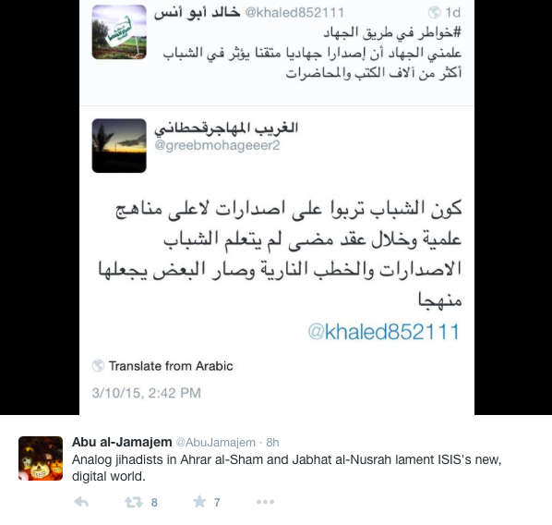
IS rivals envy use of videos
Videos “affect the youth more then a thousand times than books & sermons”

Slide 3
The mobile Culture of Syria
Physical Networks / Local
Virtual Support Networks / Global
→ wide range of data on the Internet,
ranging from jihadi forums to social media sites
→ social media jihad win-win situation
→ propaganda for everyone / hardcore beheadings – humanitarian terrorist
→ resonance among audience / adoptive propaganda

Slide 4
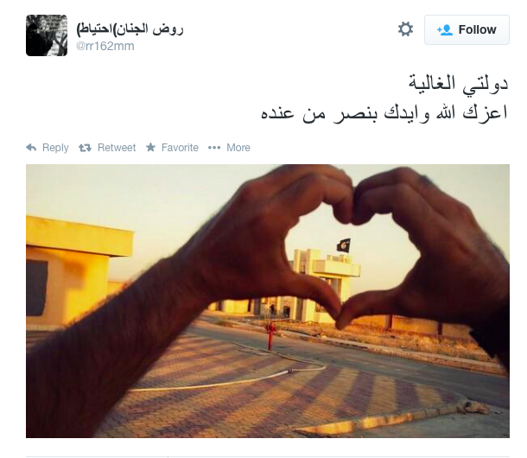
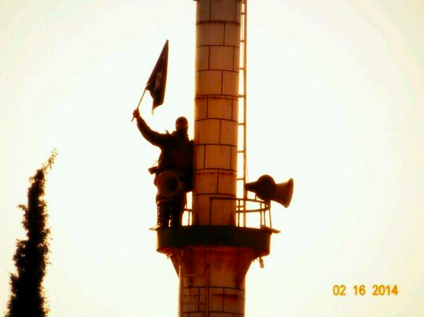
Formalize religion
Policing communities
Clear definitions of “right & wrong”
General “rules of engagement”
Jurisprudence, way of life, living the alternative
Little to no disconnect between on-/offline

Slide 5
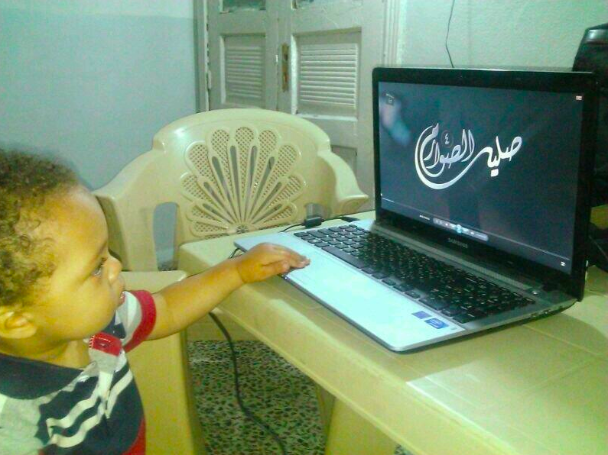
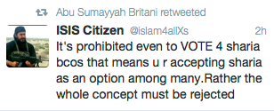
FF part of cluster networks – ISIS Samples
Foreign Fighters tend to address audience in their preferred language (oftentimes not Arabic)
Rhetorical analysis provides insight into the Arabic dominated ideology
Address to audiences with intention to incite (tahrid) shows a pop-cultural, visual literacy aspect which has become popular esp. on Twitter
Question of identity – being a “Sunni Musim” // jihadi lifestyle
Dissociation to country of residence/origin (passport burning – attaining ISIS citizenry)
Open declaration of harb ta’ifi (“confessional war”)

Slide 6
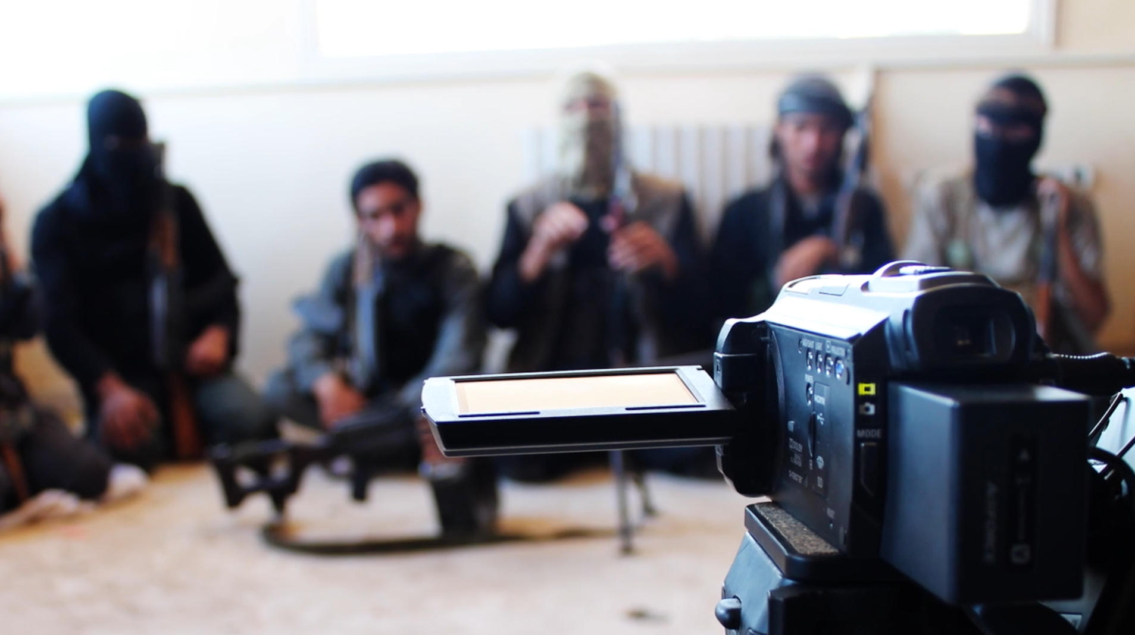
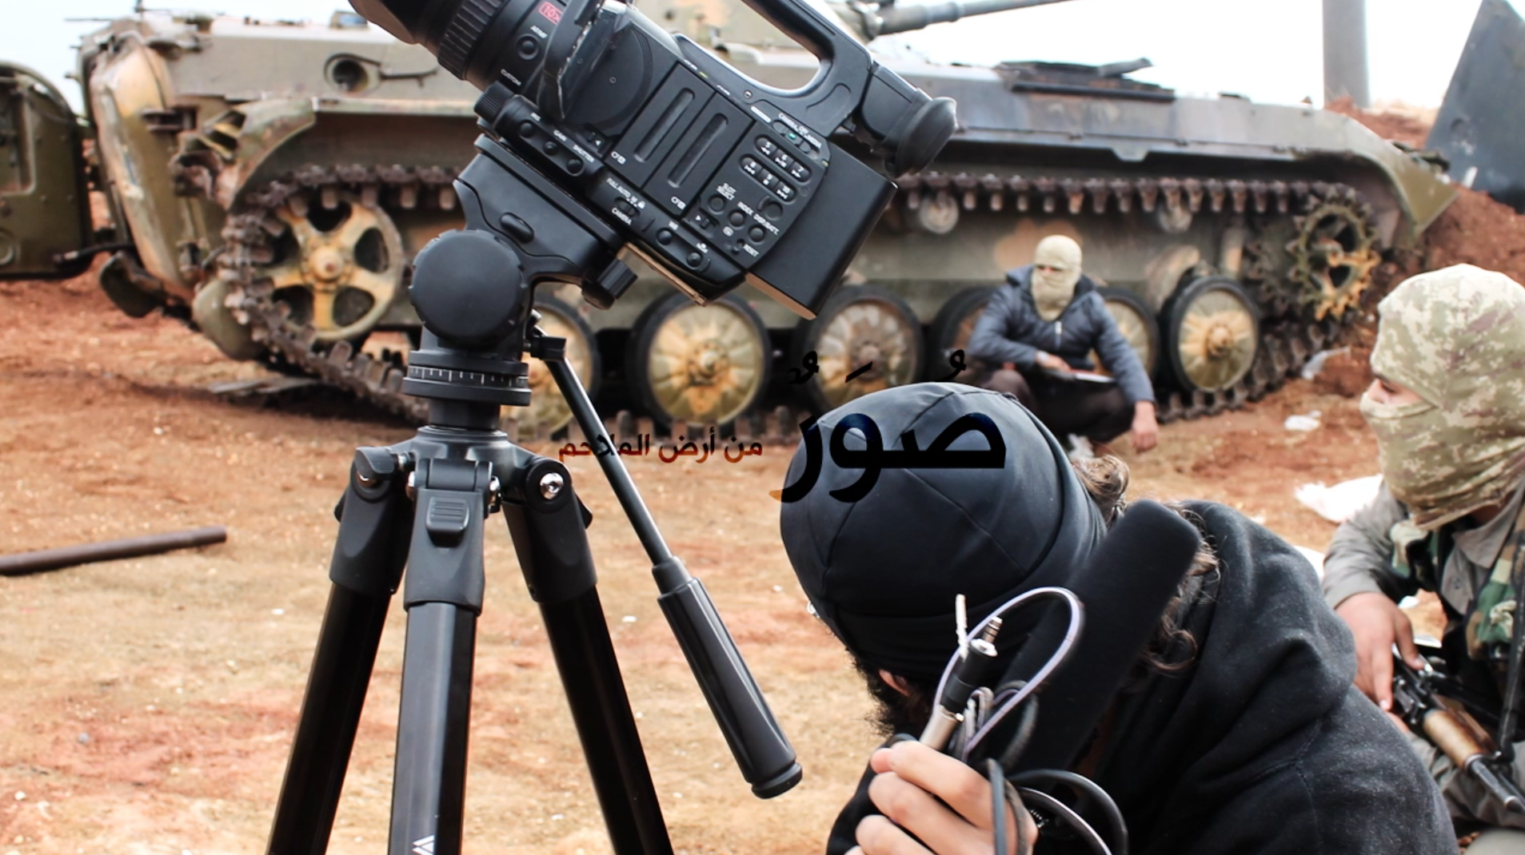
ISIS – practicality vs. AQ’s seniority
Based on AQ ideologues and texts
Massive audio-/visual output (4-8 videos per day)
Combat & media work one strategy (qital/da’wa)
Eroding borders of Sykes-Picot
Installing provinces as part of IS (Libya, Sinai etc)

Slide 7
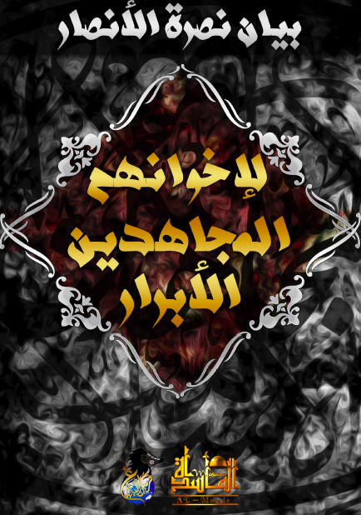
Intersections off-/Online: Media-Mujahidin
Media jihad and actors fully equated to ‘regular’ Mujahid or martyrdom ops
‘Dignitaries of Media Jihad’ plea (10/2013) for renewal of religion by jihadi parameters by media means, tahrid & qital
Jihad media most essential part and strategy
Outreach in all languages, competing with mainstream schools of thought and media
Reducing space to actual Mujahideen, “who are chosen by God to defend the umma”
Missionary work from the frontiers and the ‘hinterland’ (Islam./kuffar territory)

Slide 8
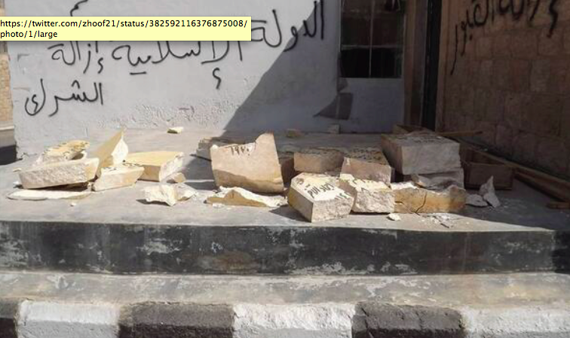
The Islamic State of Iraq and al-Sham
Protectors of Sunni communities in Iraq (al-Anbar, Ramadi, Fallujah) and Syria
Implementing shari’a law and fighting shirk; any violation of tawhid
Destruction of graves of saints, burial sites, Iranian sponsored libraries
ISIS fighting mainly non-Sunni Iraqi gov. forces adds to cluster of mutual harb ta’ifi

Slide 9
Content Analyses
Testimonies of suicide-bombers (wasiyya) or recommendations by regular fighters (nasiha)
Executions and confessions of Shabiha
Eulogies (ritha’)
Documentation of battles and post-battle assessment (shock of al-Qusayr loss)
→ example nawafidh ‘ala ard al-malahim 25; “protecting the access points of Aleppo” (November, 2013)

Slide 10
‘Proof’ of Iranian war against Sunna
Shiite missionary material ceased in various locations in Syria
In Arabic and Persian
“Passports to Paradise” (Hizbullah)
Framed by ISIS as proof of war against Sunni with aim to “destroy from within”
Jihad in Syria not only for re-establishing Caliphate / walayat but to establish safe areas
Part of ‘humanitarian cluster’ and appeal – fighting for ‘proper’ Islam, ensuring Sunni rituals, rites, norms, interpretations by jihadist standards remain / are set-up
Prison experience and tales (Iraq-Syria), violation of honor, raping of women

Slide 11
Warning: Graphic images
(For non-initiated viewers)

Slide 12
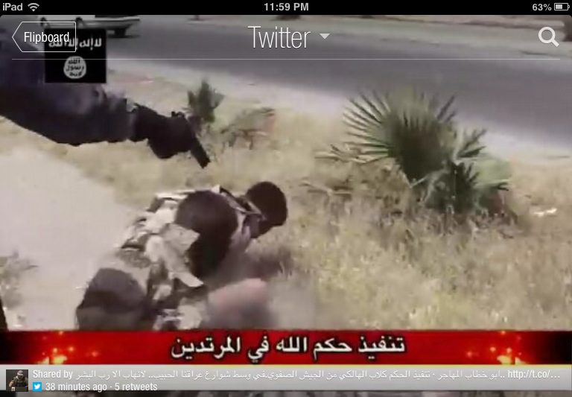
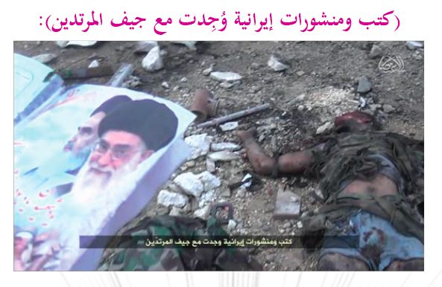
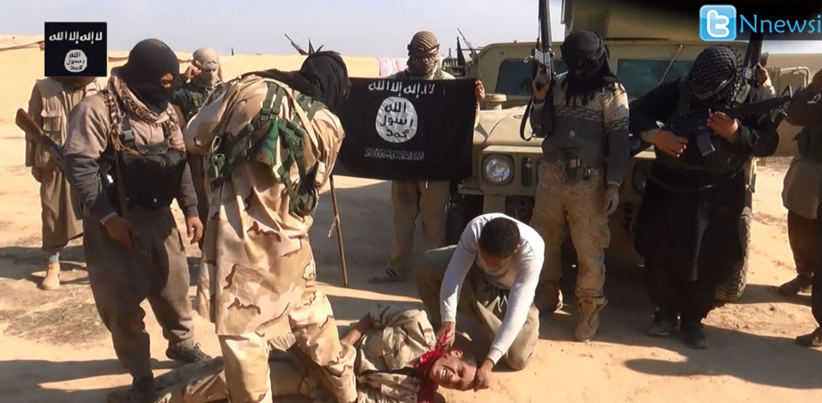
Zarqawi as the ultimate rolemodel

Slide 13
Jihadi lifestyle
Identity as Muslim means “Sunni Muslim”
Shiism as an internal threat – punishable by death
Impact on diaspora communities; rebranding Islamic identity
Mistrust among Sunni / Shia
Summary executions of “Sufis”, “Rafidis”, “Mushrikeen” by ISIS on a daily, non-stop basis
Widening of war; suicide bombings in Lebanon (Iranian Embassy), rising influence in Egypt // Libya

Slide 14
Content, Context, Communication Nodes
Audio-visual / written content analyzed as one – intersection of off-/online
New clusters of information / propaganda (Fisher/ Prucha, 2013)
Tafsir and ta’wil most powerful rhetorical elements / core of the ideology
Data influx with users posting on cross platforms (Twitter, Google+, FB, Instagram, Forums, class. Sites)
→ Propaganda as clusters, but coherent ideology, resilient and decentralized
→ Connected Fluidity to their Devices (within IS-territory // exterior global support networks)

Slide 15
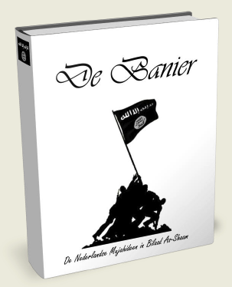
Advanced learning by cluster network
Social Media as an absolute win-win situation for jihadi media and activists
→ massive impact from Arabic propaganda; spill-over and output in local lingual context
With lesser ideological niches open, networks more cohesive
Example YouTube: Users tend to watch recommended videos
Example Twitter: key words (#) and individual networks craft alternative vision
Example Facebook: User profiles and groups as points of entry & interaction
Example Google: search words often result in radical sites first
Example Google+: in combination with YouTube and Twitter greatest outreach
Classical Online jihad forums as first but not last frontier

Slide 16
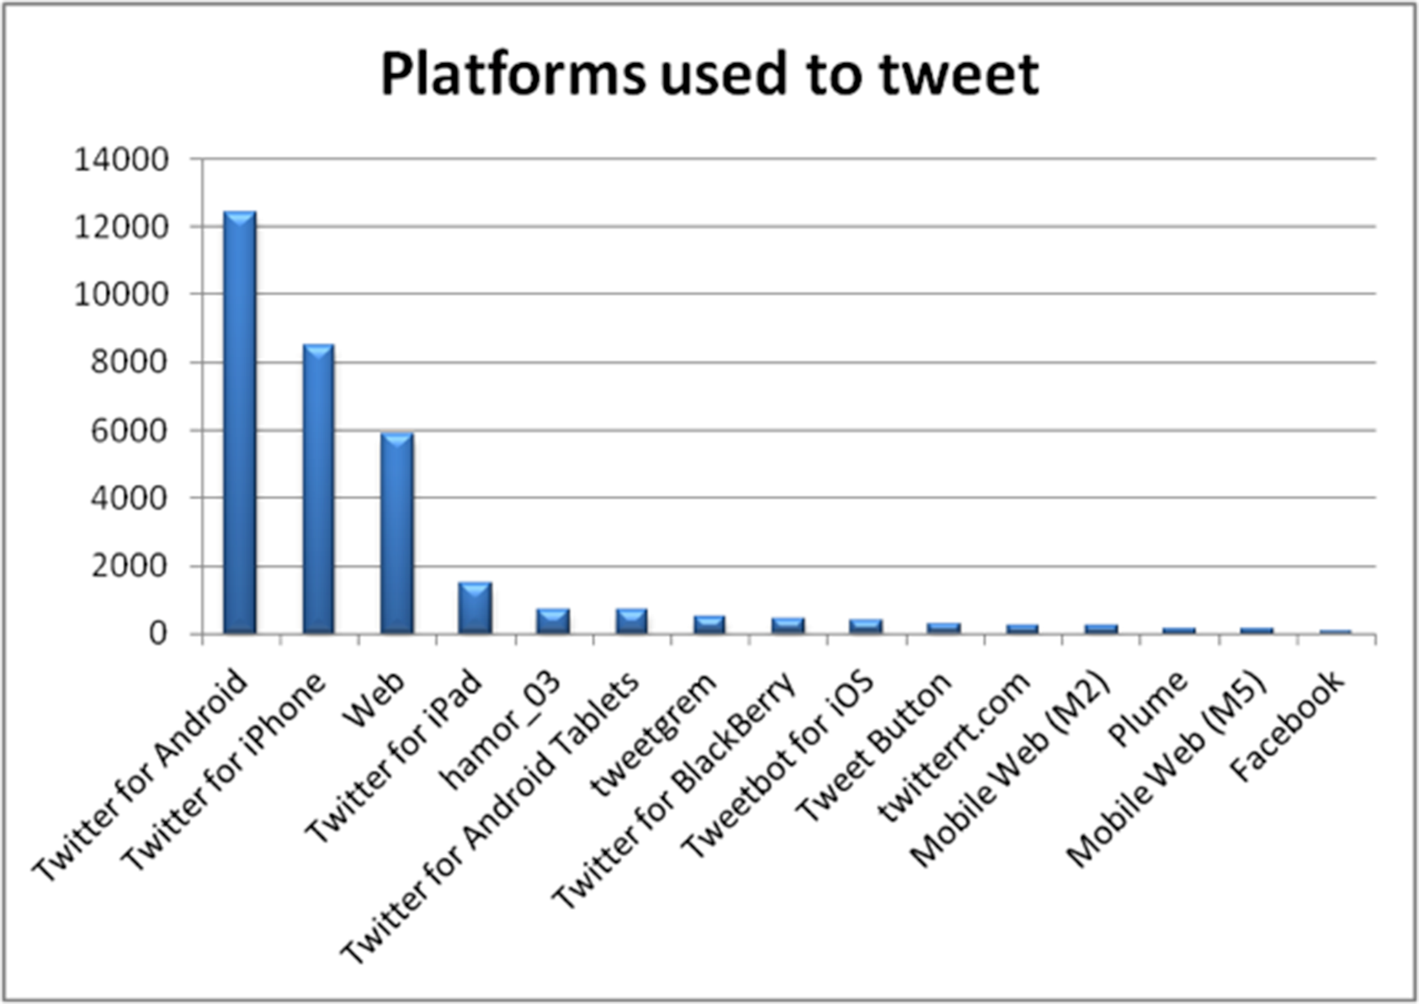
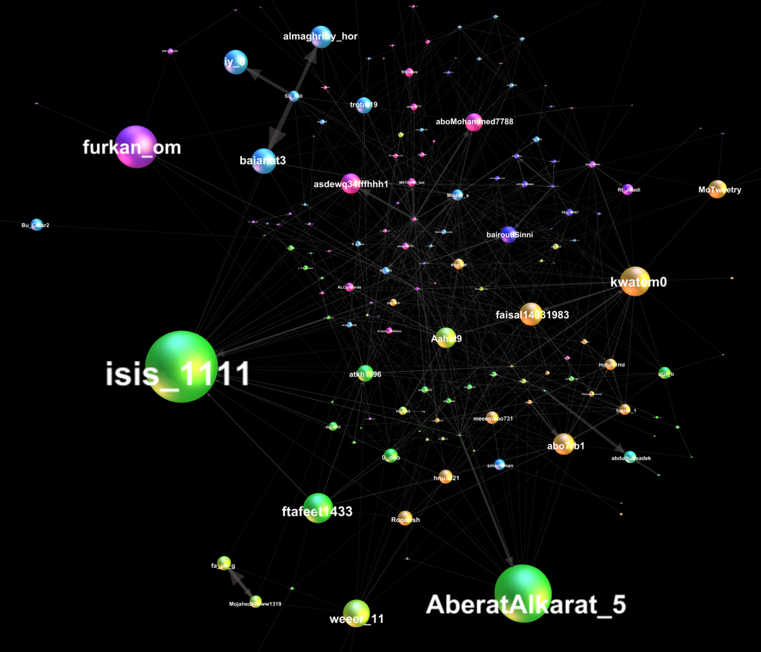
Is this the most successful release of a jihadi video ever?
Jihadica, May 2014 (Fisher/Prucha)
http://www.jihadica.com/?p=2196

Slide 17
http://bit.ly/1sxDP3w

Slide 18
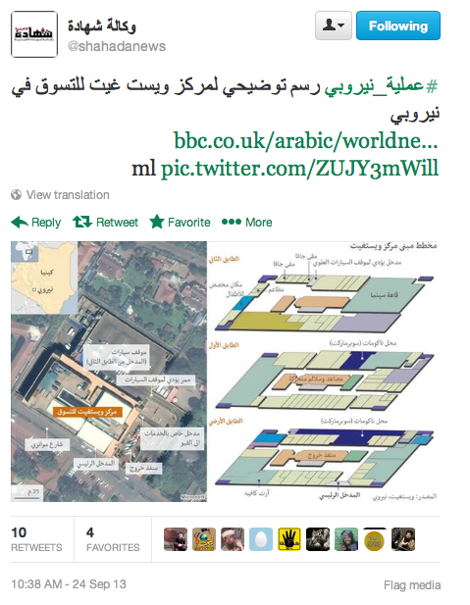
Mobile jihadi Culture in Syria

Slide 19
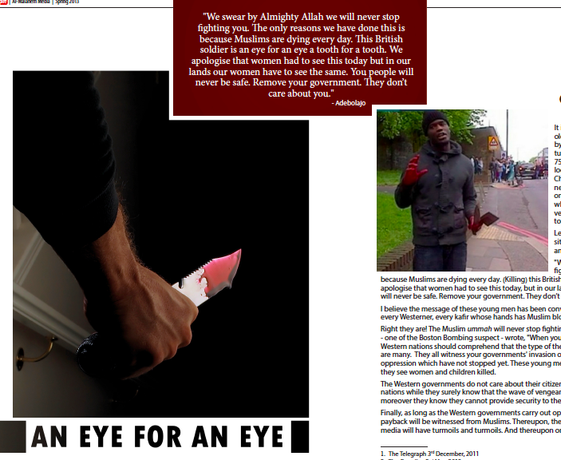
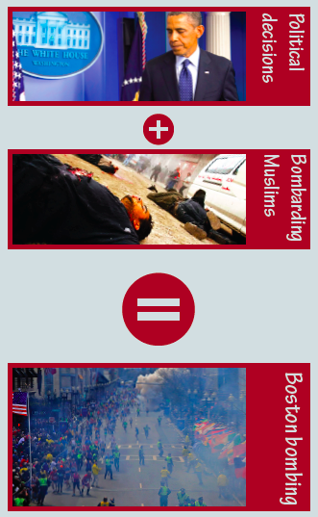
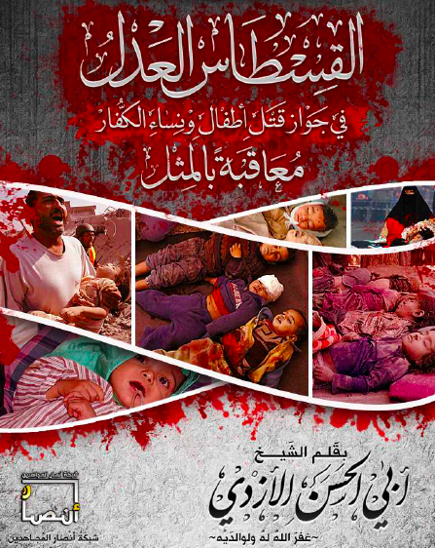
Understanding Agitprop
Ghuraba’ – ‘segregation’ / ‘rites of passage’ (Van Gennep, 1960)
Aescetiscism and iconography, audio-element of nasheed (AQAP 1.0 in Syria 2013)
Haqq / batil (‘truth’ / ‘falsehood’) scheme
Activating worshippers vs. idle state (ta’til al-shar’a)
Theological obligation to help (ighatha) and support (victory - nusra) Muslims
viral narration on genocide of Sunnis (rape, violation of hurma) at play
Al-mithl bi-l-mithl or an ‘eye for an eye’ – acts based on qistas (measuring weight)
→ (self-) identification, translating motivation in action

Slide 20
State building – winning hearts and Minds
Jihad in Syria not only for re-establishing Caliphate / walayat but to establish safe areas
Part of ‘humanitarian cluster’ and appeal – fighting for ‘proper’ Islam, ensuring Sunni rituals, rites, norms, interpretations by jihadist standards remain / are set-up
Implementation of civil and civic services
Re-launching key industry (food, oil, water) – giving out free services
Supplies for Sunni refugee camps on outskirts of ISIS territory
→ mixed narrative

Slide 21
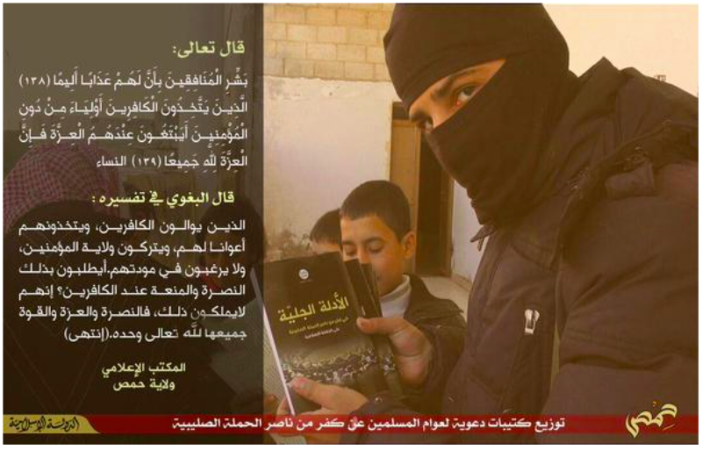
Addressing the
Aesthetic visual element &
textual content

Slide 22
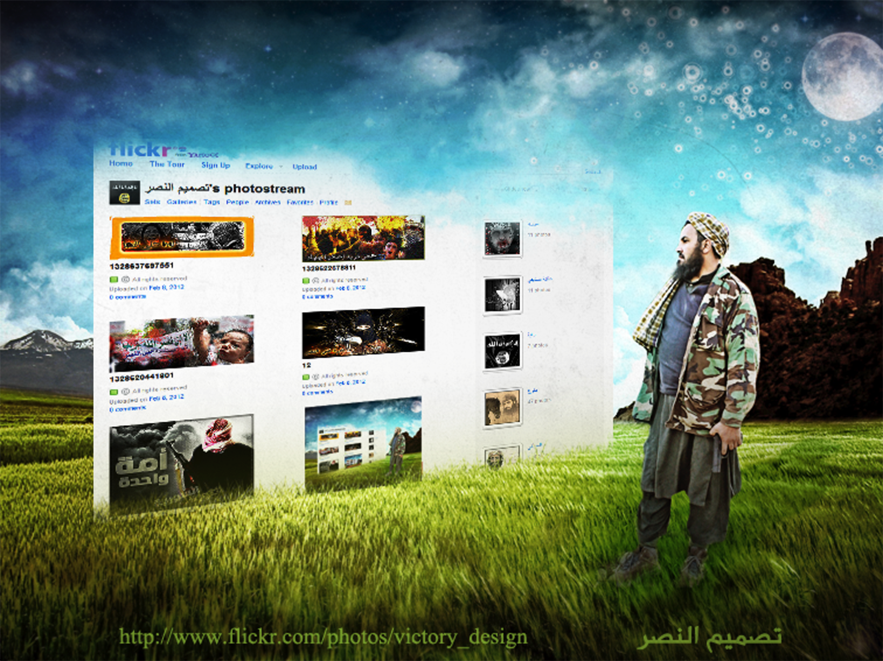
“digital information is really just people in disguise”
Jason Lanier, Who Owns the Future?, Penguin Books Ltd.: London, 2013, 52. EBook edition.

Slide 23
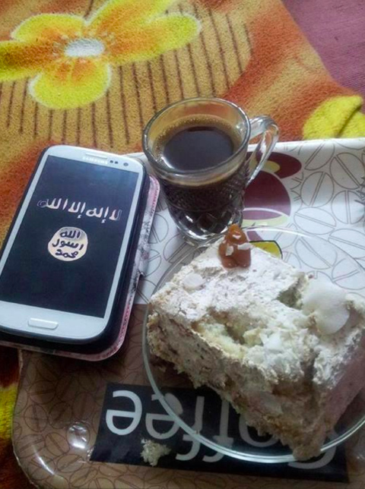
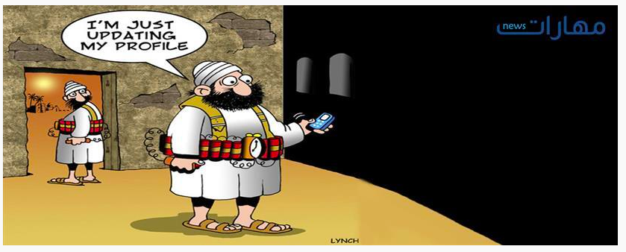
Many Thanks! Nico.prucha@univie.ac.at

